Slide 1
FIND THE
FACTS
www.druginfo.sl.nsw.gov.au
Notes:
Welcome participants and introduce the session and facilitators.
Housekeeping: toilets/fire escape/assembly area/catering/security etc
Today’s workshop session will provide you with some background information about drugs and their effects. We will discuss how drugs and classified according to their effects and legal status. We will also provide you with reference points to help and support agencies.
There will be a combination of presentations, web demonstrations and hands-on activities.

Slide 2
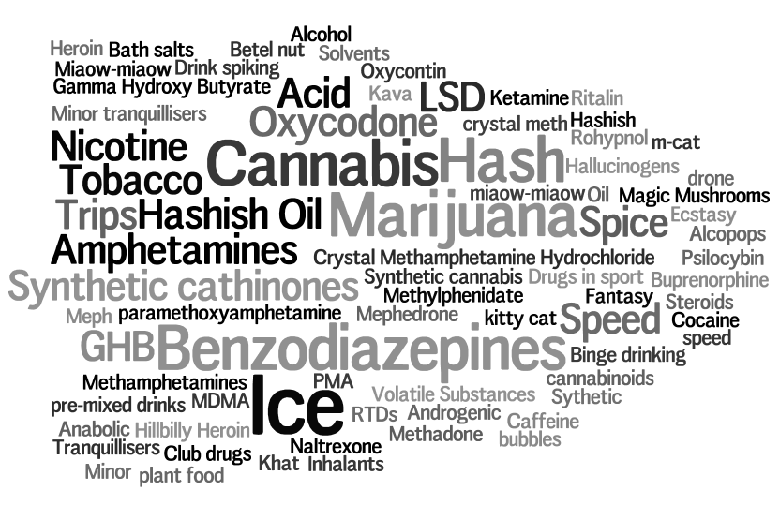
Notes:
Ask the group – So, what are drugs?

Slide 3
WHAT ARE DRUGS?
Drugs are substances that change a person's physical or mental state.
Psychoactive drugs affect the way a person thinks and feels – which may also affect the way they behave. Source: A quick guide to drugs and alcohol, 3rd edition
Notes:
Tell the group that we are going to begin by talking about what a drug is.
Drugs are substances that change a person's physical or mental state.
The vast majority of drugs are used to treat medical conditions, both physical and mental.
For example a drug like paracetamol is used to treat headaches and pain and drugs such as antidepressants are used to treat mental conditions.
Some drugs, however, are used outside the medical setting for their effects on the mind. In this session we are going to concentrate on drugs that affect a person’s mental state.
Source: A quick guide to drugs & alcohol, 3rd edition
Drugs that affect a person's mental state, whether prescribed for a medical condition (for example, antidepressants) or taken for recreational purposes (such as alcohol and heroin), are called psychoactive drugs (note – these are sometimes called recreational drugs).
Psychoactive drugs affect the way a person thinks and feels—which may also affect the way they behave.
For example:
Alcohol is a psychoactive drug.
Some of its effects include:
impaired memory and judgement (can affects thinking)
sense of relaxation (can affects feelings)
reduced inhibitions (can affect behaviour - mental - it can also change people’s demeanour – for example some people may become sad, or aggressive, others may become overly excited/boisterous)
loss of alertness and coordination, and slower reaction times (can affect behaviour – physical and mental)

Slide 4
HOW DO WE CLASSIFY DRUGS?

Slide 5
DRUG CLASSIFICATION
Drugs are usually classified according to:
their effects
whether they are legal or illicit (illegal)
The three main types of psychoactive drugs are:
depressants
stimulants
hallucinogens
Notes:
Drugs are usually classified according to:
their effects
whether they are legal or illicit (illegal)
Different types of psychoactive drugs can have differing effects – depending on the category of drug that they belong to.
The three main categories of psychoactive drugs are:
depressants
stimulants
hallucinogens

Slide 6
DRUG CATEGORIES
Depressants | Stimulants | Hallucinogens
Slow down the activity of the central nervous system (the brain and spinal cord), which reduces a person's alertness, and also slows down functions such as breathing and heart rate. | Increase the activity of the central nervous system, making the person more alert and aroused. | Make a person see, hear, smell or feel things that aren't there.
Alcohol Heroin Cannabis Benzodiazepines Inhalants | Caffeine Nicotine Ecstasy Methamphetamine Cocaine | LSD Magic Mushrooms Datura
Notes:
DEPRESSANTS slow down the activity of the central nervous system (the brain and spinal cord), which reduces a person's alertness, coordination and concentration and also slows down functions such as breathing and heart rate.
In small quantities depressants can cause a person to feel more relaxed. In large quantities they can cause unconsciousness, vomiting and death.
Examples of depressants are alcohol, heroin, cannabis, the prescription drug group of benzodiazepines (sometimes referred to as benzos) and other prescription tranquilisers.
(Ask the group if they know what benzodiazepines are as many people have not heard of them – benzodiazepines belong to a group of drugs known as minor tranquilisers, examples of benzos are Valium and Xanax – they are prescription drugs that may be used as recreation drugs)
Click to reveal
STIMULANTS increase the activity of the central nervous system, making the person more alert and aroused. They increase heart rate, body temperature and blood pressure.
They can also reduce a person’s appetite and cause them to have dilated pupils and difficulty sleeping, and to be talkative or agitated. Large quantities or stimulants can cause a person to experience anxiety, panic, seizures, headaches, stomach cramps, aggression and paranoia.
Strong stimulants can mask some of the effects of depressant drugs such as alcohol.
Examples of mild stimulants are nicotine, caffeine, and examples of strong stimulants are cocaine, ecstasy and methamphetamines, speed and ice.
Click to reveal
HALLUCINOGENS make a person see, hear, smell or feel things that aren't there.
Other effects of hallucinogenic drugs include dilation of the pupils, loss of appetite, increased activity, talking or laughing, a sense of emotional and psychological euphoria and well-being, jaw-clenching, sweating, panic, paranoia, loss of contact with reality, irration or bizarre behavior, stomach ramps and nausea.
Examples of hallucinogens are LSD, magic mushrooms, ecstasy and cannabis.
NOTE: some drugs fit into more than one category – so CANNABIS acts as a depressant by reducing a person’s alertness but can also be a hallucinogen, causing someone to see, hear or feel things that are not there. The same applies for a drug such as ECSTASY which is a stimulant and can have hallucinogenic effects.
Source: A quick guide to drugs and alcohol, 3rd edition, Drugs and their effects, Alcohol and Drug Foundation

Slide 7
Legal and illicit drugs
Legal and illicit drugs
In NSW it is an offence to use, produce or supply a drug which has been declared prohibited by the Drug Misuse and Trafficking Act 1985
Examples of illicit drugs:
heroin
cocaine
and cannabis
Notes:
Another way of grouping drugs is as “legal” or “illegal” (also known as illicit) drugs.
There are many laws around drugs and drug use in Australia.
Firstly, there are laws are around illicit drug use. Illicit drugs include illegal or prohibited drugs (such as cannabis, opiates, and certain types of stimulants), pharmaceutical drugs (such as pain-killers and tranquillisers) when used for non-medical purposes, and other substances used inappropriately (such as inhalants).
In NSW it is an offence to use, produce or supply a drug which has been declared prohibited by the Drug Misuse and Trafficking Act 1985 (source: A quick guide to drugs and alcohol). This Act contains a list of drugs and prohibited plants (eg cannabis and opium) in the Schedules. The Commonwealth Criminal Code deals with the importing and exporting of drugs.
However, even so-called “legal drugs” can have many laws and regulations surrounding their production, sale and usage.
For example – alcohol – there are laws that cover:
Drinking age and age of purchase
Liquor licensing laws – Responsible Service of Alcohol
Secondary supply (supplying of alcohol to minors)
Drinking in public places
Alcohol advertising and packaging
Drink driving laws
Note:
Some drugs may be legal in one situation and illegal in others. An example would be benzodiazepines or minor tranquilisers such as Valium. Benzodiazepines can be prescribed by doctors and are legal if used as prescribed. However it is illegal to use benzodiazepines without a prescription, or to give or sell them to other people and also to drive if you are using unprescribed benzodiazepines.
Similarly drugs such as alcohol and tobacco can be purchased and used legally in many circumstances but have other laws around them – eg supply to minors, blood alcohol limits while driving, smoking in public places etc.
ACTIVITY
Ask the group to tell you what they believe the most commonly used LEGAL psychoactive drug is.
A: The most commonly used legal psychoactive drugs, apart from drugs taken on prescription, are alcohol and tobacco.
Ask the group to tell you what the most commonly used ILLEGAL psychoactive drug is.
A: The most commonly used illegal psychoactive drug is cannabis (marijuana).

Slide 8
WHAT DRUGS
DO PEOPLE USE?

Slide 9
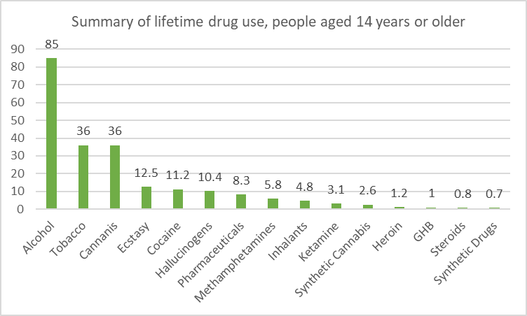
WHAT DRUGS DO PEOPLE USE?
Source: Australian Institute of Health and Welfare, National Drug Strategy Household Survey 2019
Notes:
So what types of drugs do people use?
This graph shows the prevalence of drug use by drug type in Australia – it is taken from the National Drug Strategy Household Survey, which is a survey undertaken every three years.
This graphs lists the percentage of Australians (aged 14 years and older) who have ever used a drug at some time in their life.
As you can see from the graph – alcohol, tobacco and ecstasy have the highest use with drugs such as GHB and Ketamine having a much smaller amount of usage.
NB (Ice is included under ‘methamphetamines’ – it is currently at 5.8% of the population who has ever tried any form of the drug)
NOTES:
The intention of this slide is to put Australian’s use of alcohol and other drugs in perspective.
This data has been collected through the National Drug Strategy Household Survey (NDSHS) which has been conducted in Australia since 1985. Its is important to stress two things when presenting information on this slide:
This is population data of what is happening in ‘average’ households all over Australia meaning it is not necessarily representative of what is happening in this particular ‘community’. (Not included in NDSHS survey is data from ‘at risk populations” such those in gaol, homeless, etc. )
That alcohol is still our biggest problem drug, especially when compared to the prevalence of methamphetamines. (Almost 8/10 Australians used alcohol in the past year, compared to less than 1/50 Australian’s reporting using of any form of methamphetamines in the past year)
The 2019 National Drug Strategy Household Survey collected information from almost 23,000 people over the age of 14 across all Australian jurisdictions on their tobacco, alcohol and illicit drug use, attitudes and opinions.
This information shows how many people reported they had ever used the drug in their lifetime (worth noting that is used at least once - could just be a single time). For example with methamphetamines the “ever used/tried” figure is 5.8% of the population, however when you compare this to “recent use” this drops to 1.3% of the Australian population that has used any form of the drug in the past year.

Slide 10
Where do I
FIND THE FACTS?
Notes:
Where can the facts about alcohol and other drugs?

Slide 11
DRUG INFO in your public library and online
Add your library logo
Notes:
Here in this library we provide a service called Drug Info, where you can find information about alcohol and other drugs.
What is Drug Info?
Drug Info provides up to date information about alcohol and drugs via a dedicated website and through public libraries in NSW. Drug Info is a joint initiative of NSW Health and the State Library of NSW and is funded by NSW Health.
We are now going to look at some of the resources that the service provides that can help you find the facts about drugs and alcohol.

Slide 12
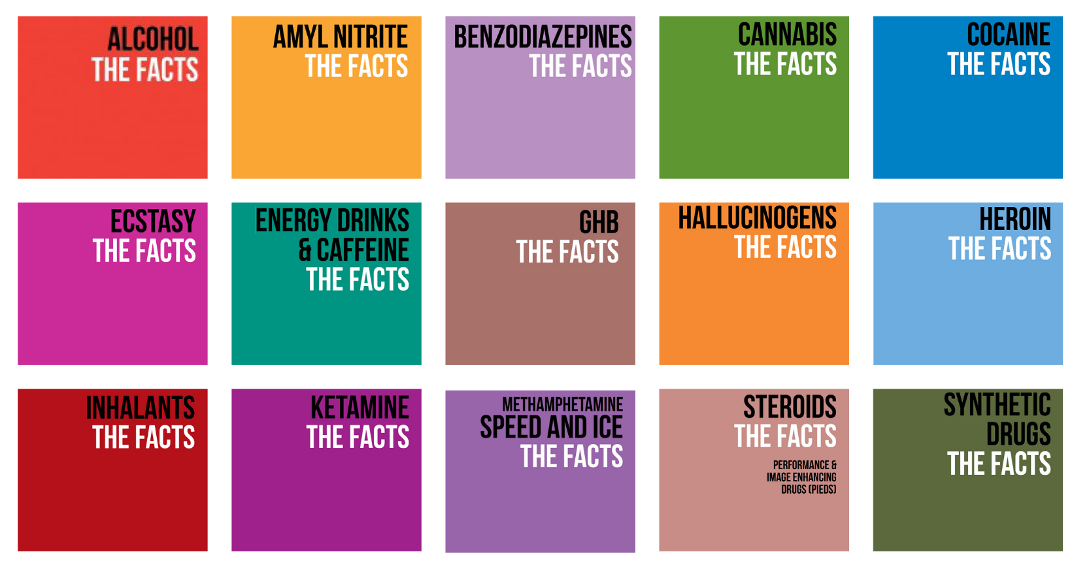
Notes:
The simplest way to find drug information is through factsheets. In this library there is a collection of booklets produced by NSW Health called “The Facts” on a range of legal and illegal drugs. These booklets are also available to download in PDF via the Drug Info website.
Demonstrate ONE booklet.
Each booklet contains information which can include:
Brief description of the drug and what it looks like
Info about its effects – what it might do to your body in the short and long term if you were taking it
Warnings about mixing with other drugs, including alcohol
The legal status of the drug
Information about driving under the influence of the drug
Information about taking the drug during pregnancy and/or breastfeeding
What to do in an emergency
Information about the possibilities of overdose
Treatment options
Withdrawal symptoms
On the back of each booklet there is also a list of agencies and helplines which is useful if you or anyone that you know should ever need help with a drug or alcohol related issue.

Slide 13
Notes:
Exercises using Drug Facts and Quick Guide
Now that we’ve heard some background information about drugs – let’s take a look at some of the Drug Facts to find out some more detailed information.
Choose a drug from the drugs listed on the sheet and use the NSW Health Drug Facts booklets to find an interesting fact to share with the group.
The “interesting fact” could be something that you didn’t know about the drug, something that you personally find interesting or something that you think is an important fact that people should know about.
Reconvene the group after 5-10 mins
Ask participants to share ONE interesting fact about the drug that they researched with the group

Slide 14
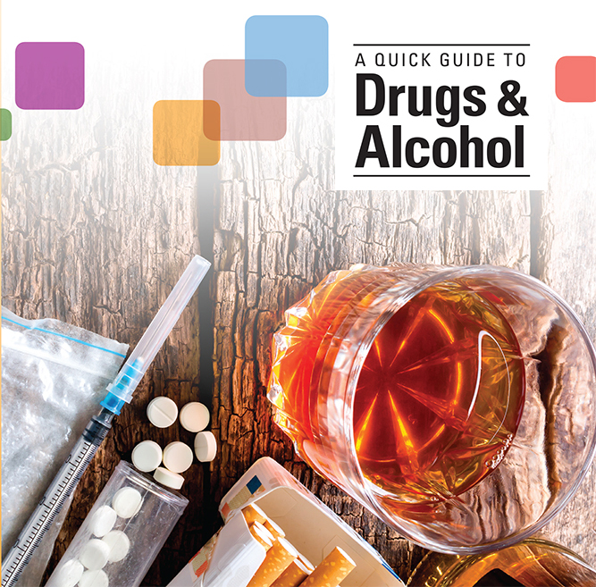
Notes:
You can also find more information in the Drug Info book and pamphlet collections in the library.
The key resource in the Drug Info book collection in public libraries is A quick guide to drugs and alcohol – a plain language reference book commissioned by Drug Info. This book includes information on a range of drugs, drug effects, drugs and driving, pregnancy, treatment, statistics.
It also has a chapter on drugs and the law.
A hard copy of the book is available [in reference and for loan] in this library.
The PDF version of the book is available to download from the website.

Slide 15
BOOKS & PAMPHLETS IN PUBLIC LIBRARIES
Notes:
There are also other books in the library collections relating to drugs including these titles:
Alcohol, other drugs and pregnancy 5th edition
A guide to coping: support for families faced with problematic drug use
Healthy spirit healthy community – a guide to drugs and alcohol in our community
Teenagers, Alcohol and Drugs: what your kids really want and need to know about alcohol and drugs
A quick guide to drugs & alcohol 3rd edition
There is also a range of pamphlets available (in the library) or to download from the Drug Info website. Some are specifically related to cannabis use.

Slide 16
www.druginfo.sl.nsw.gov.au
Notes:
[NOTE – this section can also be done as a live demo on the website – www.druginfo.sl.nsw.gov.au – participants could follow along on devices or PCs]
We will now take a brief look at the Drug Info website. The print collections provide access to information to around 15 different drugs.
The Drug Info website provides access to an extended range of drug information with quality assured links, downloadable factsheets and access to support networks.
The main collection of information is listed under the A-Z of drugs – accessible via the homepage or under the ‘drugs’ tab

Slide 17
Notes:
Click on A-Z of Drugs

Slide 18
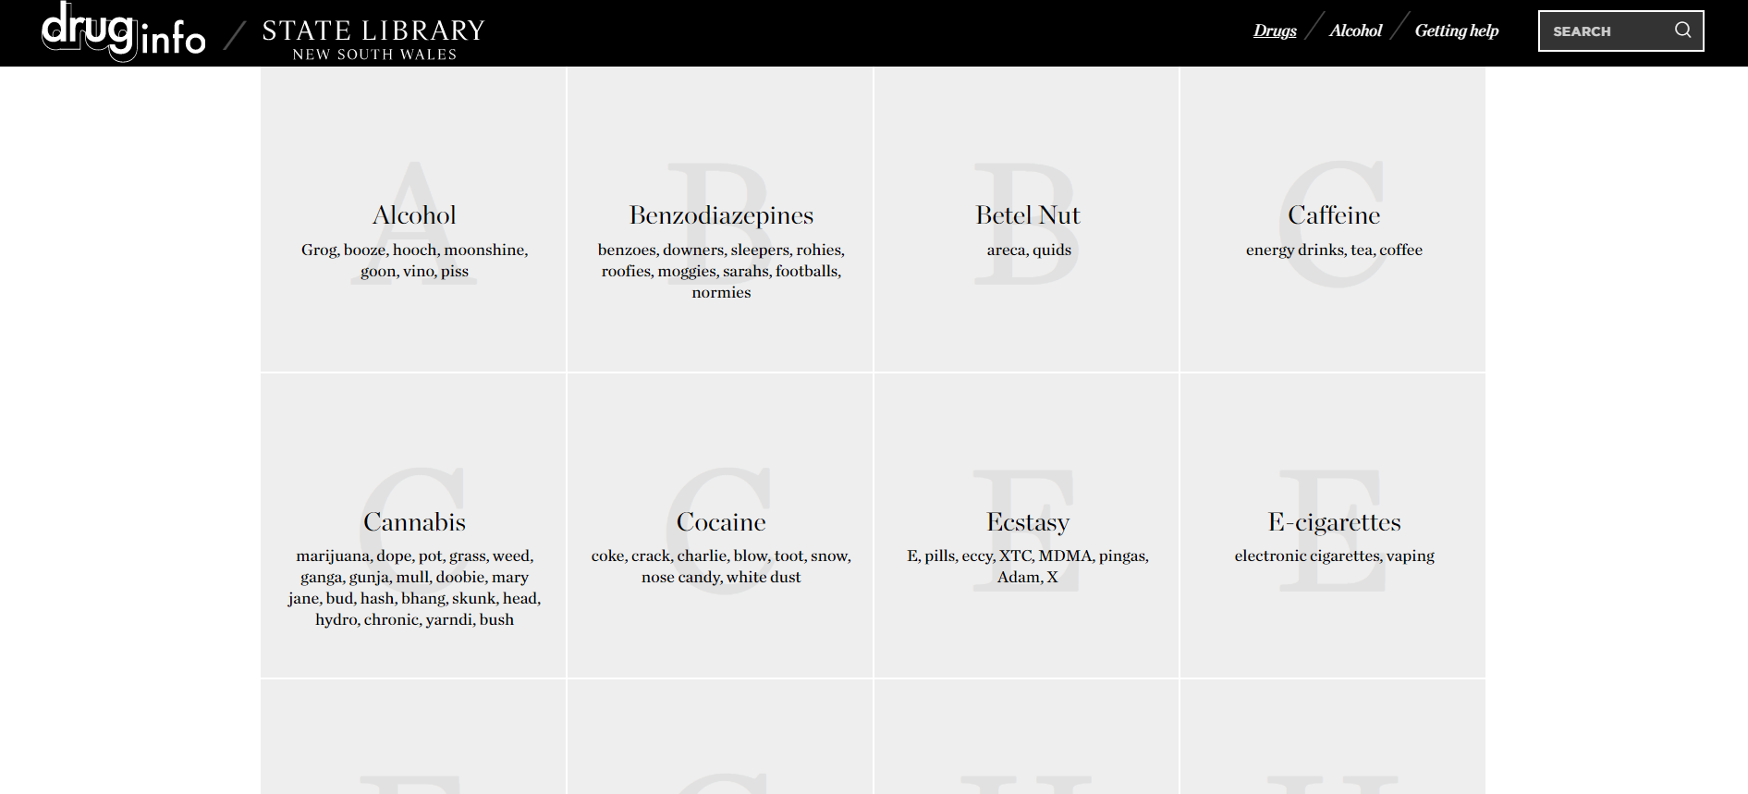
Notes:
This section contains an alphabetical index to pages on individual drugs, indexed by proper and street name. Drugs may be listed twice. Drugs may also be listed by groups such as hallucinogens, analgesics, new and emerging drugs etc.

Slide 19
Notes:
Where possible we provide full text information and images.
We include information about:
Street names
How a drug is used
The legal issues around the drug
Long and short term effects
Statistics around the use of the drug
Other issues such as the link between mental health and use of the drug
We also provide links to quality websites and reports.
The full text information on the website is taken from the key resource in the Drug Info collection - A quick guide to drugs and alcohol

Slide 20
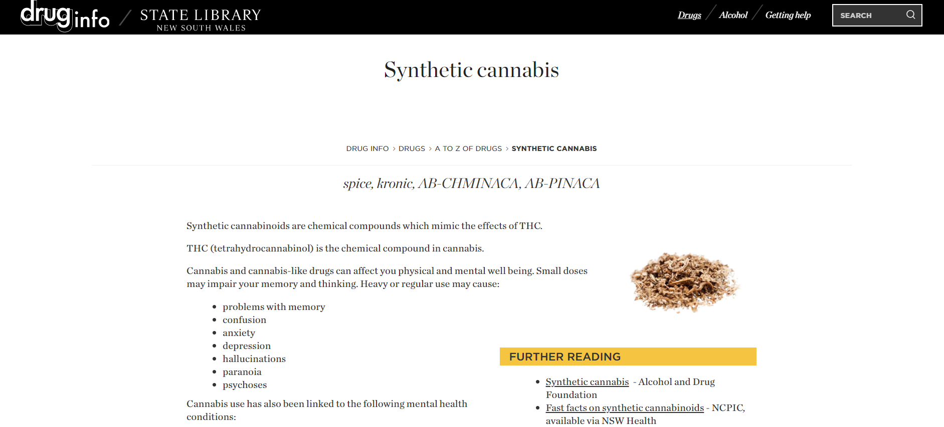
Notes:
For drugs where full text information is not available the website provides link to quality websites, pamphlets and reports either in Australia or overseas. Links to related drugs are also provided.
Drug Info attempts to collect links to information about new and emerging drugs where possible – these may be so called legal highs or other drugs mentioned in the media.
OPTIONAL ADDITIONAL EXERCISE IF USING LIVE DEMO & DEVICES (10 mins)
Ask participants to go to the A-Z of Drugs page – www.druginfo.sl.nsw.gov.au/drugs/list/index.html
Choose a drug from the A-Z list
Have a look at the information available about the drug. Is there full text information available? If not, is there a link to another website – which website did it link you to?
Explore the information available about your chosen drug:
What are its effects?
Is there a downloadable brochure/pamphlet/PDF available?

Slide 21
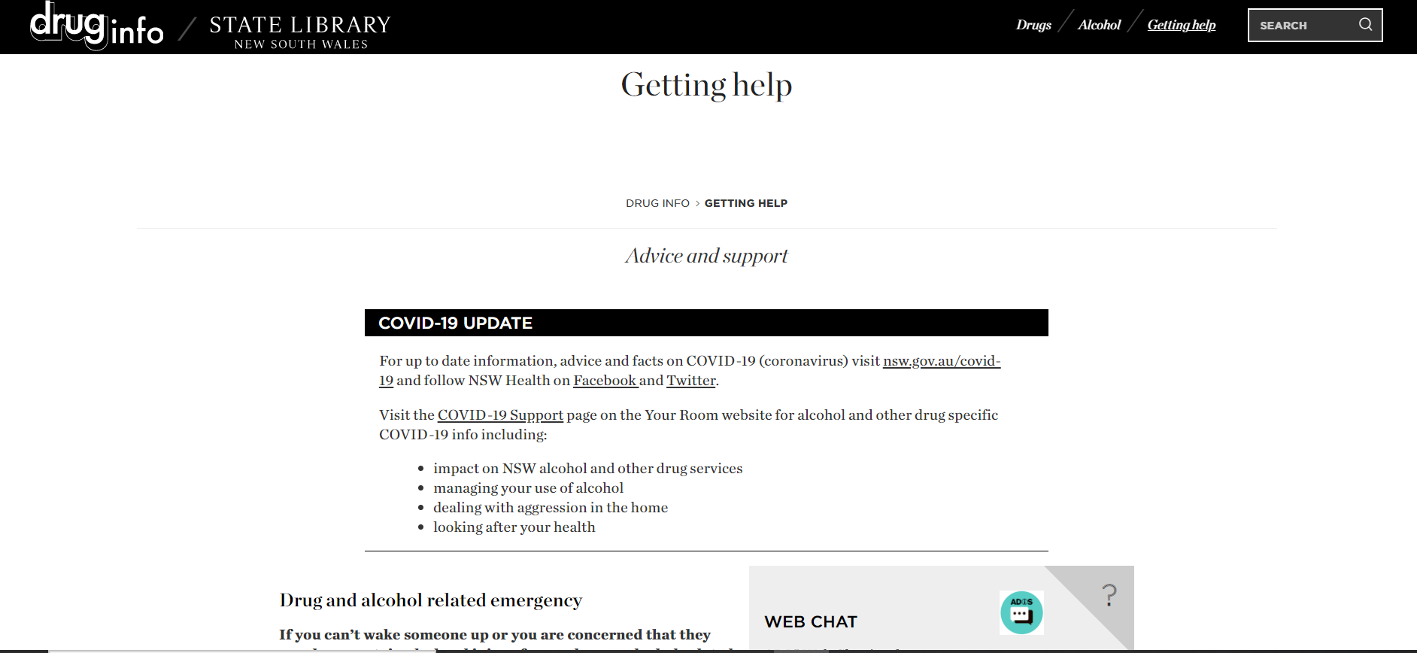
Notes:
If you or anyone that you know should ever need help with a drug or alcohol related issue – you can find a list of agencies by clicking on the ‘Getting Help’ button
Things to note:
Counselling Online provides one-to-one counselling over the Internet or phone.
Family Drug Support provides support to families and friends in crisis due to drug and alcohol issues
Lifeline provides support for mental health issues and crisis support
ADIS provides specialised information and referral and is a 24hr service – it also have a Stimulant Treatment Line (ie for ice and speed)

Slide 22
Notes:
Any further questions?

Slide 23
Notes:
Thank you for attending today’s session.
Ask participants to fill in an evaluation form and hand it to the facilitator – this helps us improve the content of the session for future participants. All data we collect is anonymous and confidential.
Hand out information packs.

